Slide 1



Tangible benefits of marine park management for human well-being
Great Barrier Reef Marine Park Authority: Margaret Gooch, Kirstin Dobbs, Karen Vohland, Liz Wren, Hugh Yorkston
CSIRO: Erin Bohensky, Ally Lankester, Nadine Marshall, Petina Pert, Samantha Stone-Jovicich
James Cook University: Natalie Stoeckl, Renae Tobin
ICRS Conference 9-13 July, 2012 - Cairns
Symposia Theme - Management and Monitoring Theme
Mini-symposia 18a - Evaluating management success

Slide 2
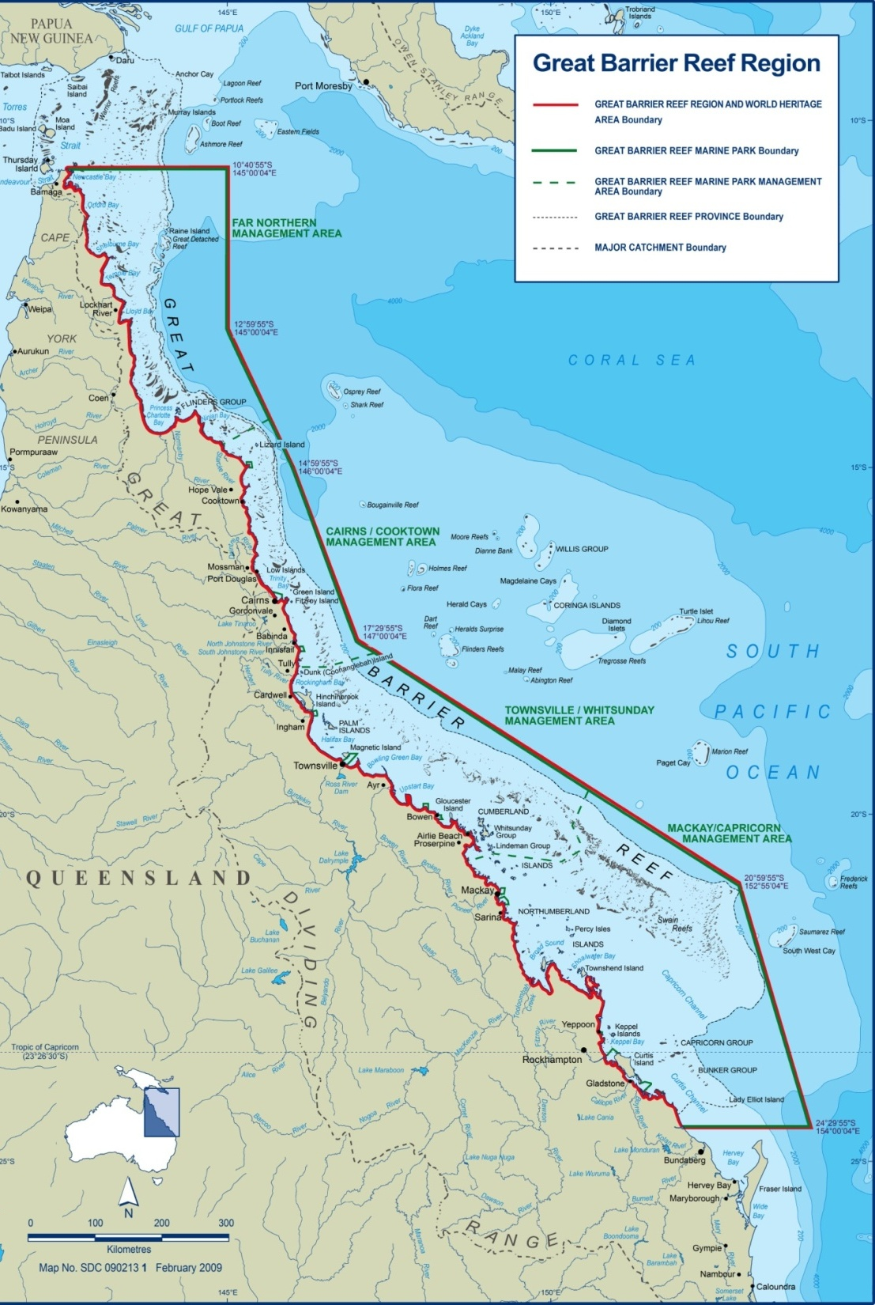
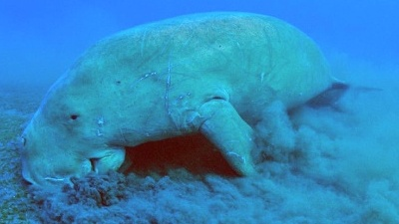
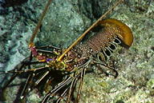
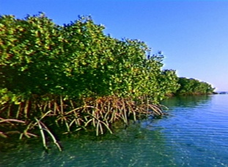


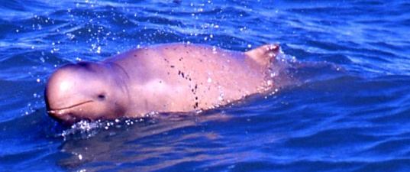
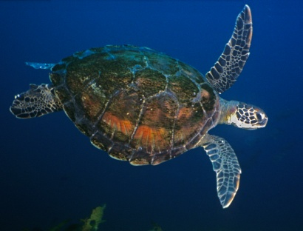

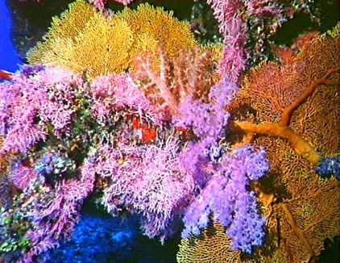
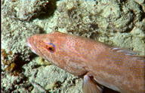
Notes:
World’s most extensive coral reef ecosystem - covers 346,000 km2
2900 coral reefs & more than 1000 islands
Thousands of marine species
1975 - GBR Region declared under the GBRMP Act
Act provides for the long term protection and conservation of the environment, biodiversity and heritage values of the Great Barrier Reef Region
1981 – declared World Heritage Area for its outstanding universal value. No other WHA contains such biological diversity
2007 - National Heritage property
The Great Barrier Reef is one of the most extraordinary places on Earth. We take our role in caring for it very seriously.

Slide 3
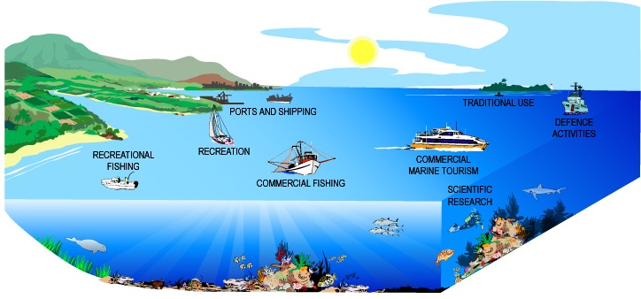
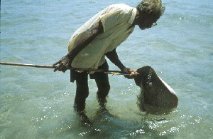
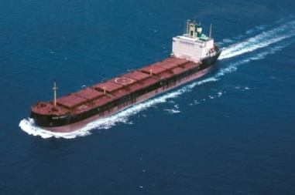
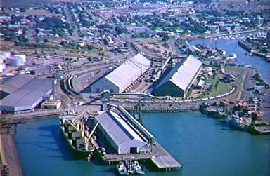
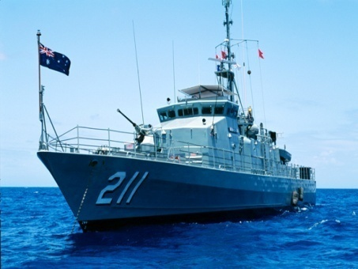
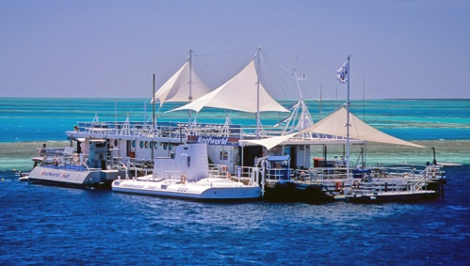
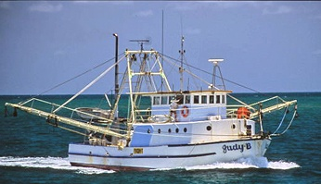
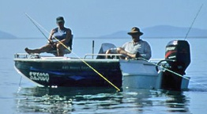
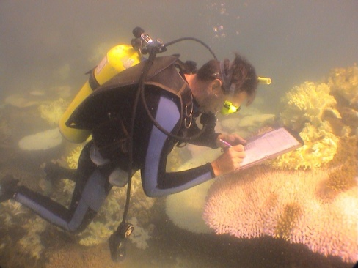
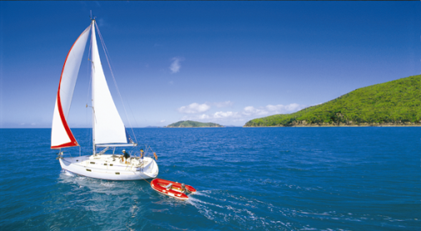
Uses of the Reef
Notes:
Multiple use park –
research,
tourism,
commercial fishing,
recreational fishing,
traditional use,
sailing,
Defence,
ports and
shipping
Collectively it is estimated these are worth in excess of AUD $5 billion per annum to the Queensland and national economy
This estimate of $5 Billion p.a is primarily comprised of tourism (about two-thirds) , but also includes the substantial values associated with all reasonable forms of commercial fishing, including bottom trawling, line fishing, netting and various harvest fisheries, as well as substantial levels of recreational fishing.
However the $5 billion does not include the intangible values of such things as ecosystem services, cultural values, or the immeasurable value of rare and threatened species.

Slide 4
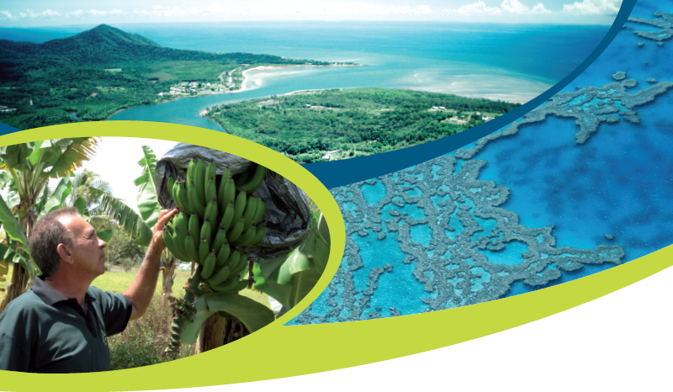


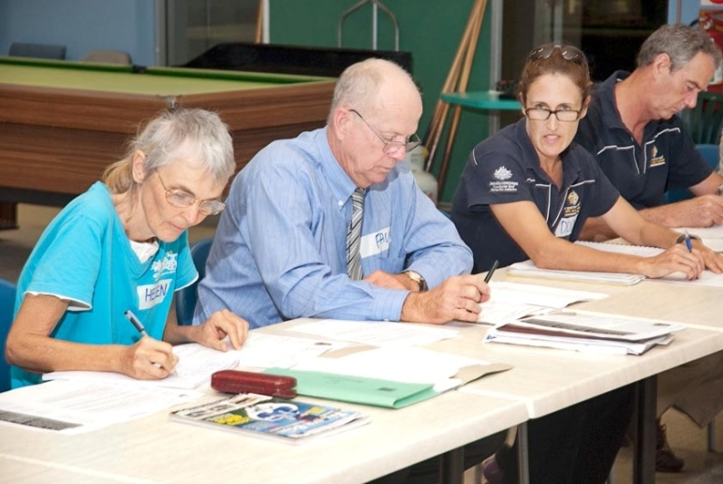
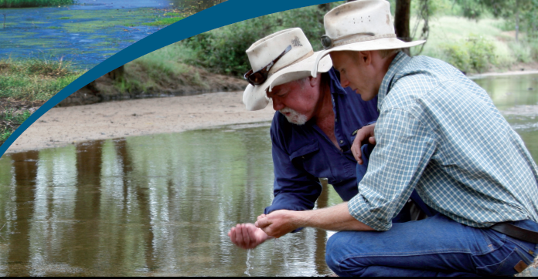
Notes:
OUR OPERATING PRINCIPLES include
• ecosystems-based management approach
• using the best available science, and the 'precautionary principle' to guide decision-making
encouraging behavioural change within the community
• Respecting Traditional Owner culture and recognise connections to Sea Country within the Marine Park
Management of the GBR is highly dependent on partnerships with other non-government and community groups
Reef Guardians
builds relationships with stakeholders and fosters a culture of appreciation and caring for the Reef
Includes Schools, Councils, Farmers and Fishers
More than 230 schools and 13 councils from Bundaberg to Cooktown
Local Marine Advisory Committees (LMACs)
Voluntary committees that advise GBRMPA on management issues about the Marine Park at a local level
First established in 1999 and now 12 LMACs along the Qld coast
An opportunity for local communities to give direct feedback on management and have ownership for that decision
Science and research
Management of the Marine Park and World Heritage Area is based on science
Partners include AIMS, JCU, Australian Research Council centre for Excellence for Coral Reef Studies, National Environmental Research Program (NERP), the Marine and Tropical Sciences Research Facility, Centre for Marine Studies and UQ
Industry partners
Work closely with commercial fishing industry and tourism industry on programs and initiatives to help the sustainability of these industries
Traditional Owners
Today there are approximately 70 Traditional Owner groups whose sea country includes the Great Barrier Reef Marine Park.
GBRMPA works with Traditional Owners to develop a suite of sea country management arrangements including Traditional Use of Marine Resources Agreements (TUMRAs) and Marine Park Indigenous Land Use Agreements (ILUAs).
The GBRMPA fosters Indigenous community engagement through membership on the Authority Board and the Indigenous Reef Advisory Committee (IRAC), Science and Management Workshops for Traditional Owners, compliance training, monitoring and Traditional ecological knowledge projects.

Slide 5
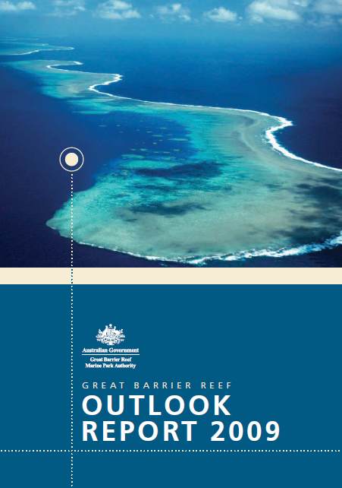
Outlook Report
Benefits of use
ACTIVITY/USE | BENEFITS
Marine tourism | presentation, management, economic value.
Defence | training & operations of Australia's defence services
Fishing | recreation, seafood, economic value
Ports and shipping | service coastal Queensland industries & communities
Recreation (excluding fishing) | high levels of visitor satisfaction
Scientific research | best available information for management
Traditional Use of Marine Resources | provides environmental, social, economic & cultural benefits to TOs and sea country
Great Barrier Reef Marine Park Authority (2009). Outlook Report 2009. http://www.gbrmpa.gov.au/outlook-for-the-reef/great-barrier-reef-outlook-report page 84

Slide 6
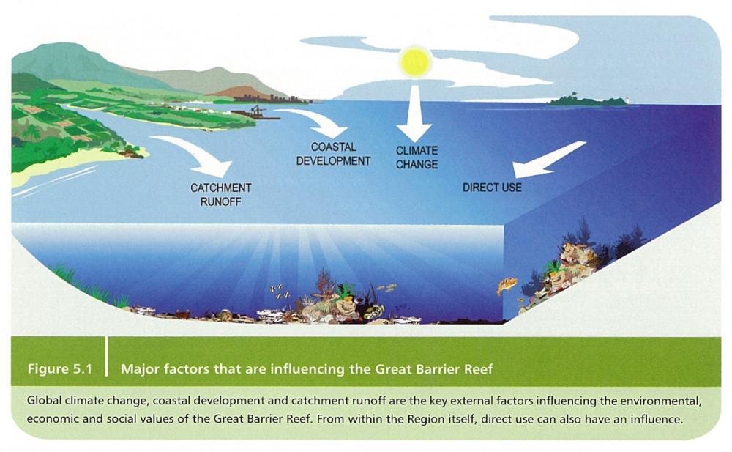
Outlook Report
Key Questions
What are the current state and trends of the Great Barrier Reef's environmental, economic, social & cultural values?
What is affecting the Great Barrier Reef's environmental, economic, social & cultural values?
How have management activities made a difference?
Great Barrier Reef Marine Park Authority (2009). Outlook Report 2009. http://www.gbrmpa.gov.au/outlook-for-the-reef/great-barrier-reef-outlook-report page 84

Slide 7
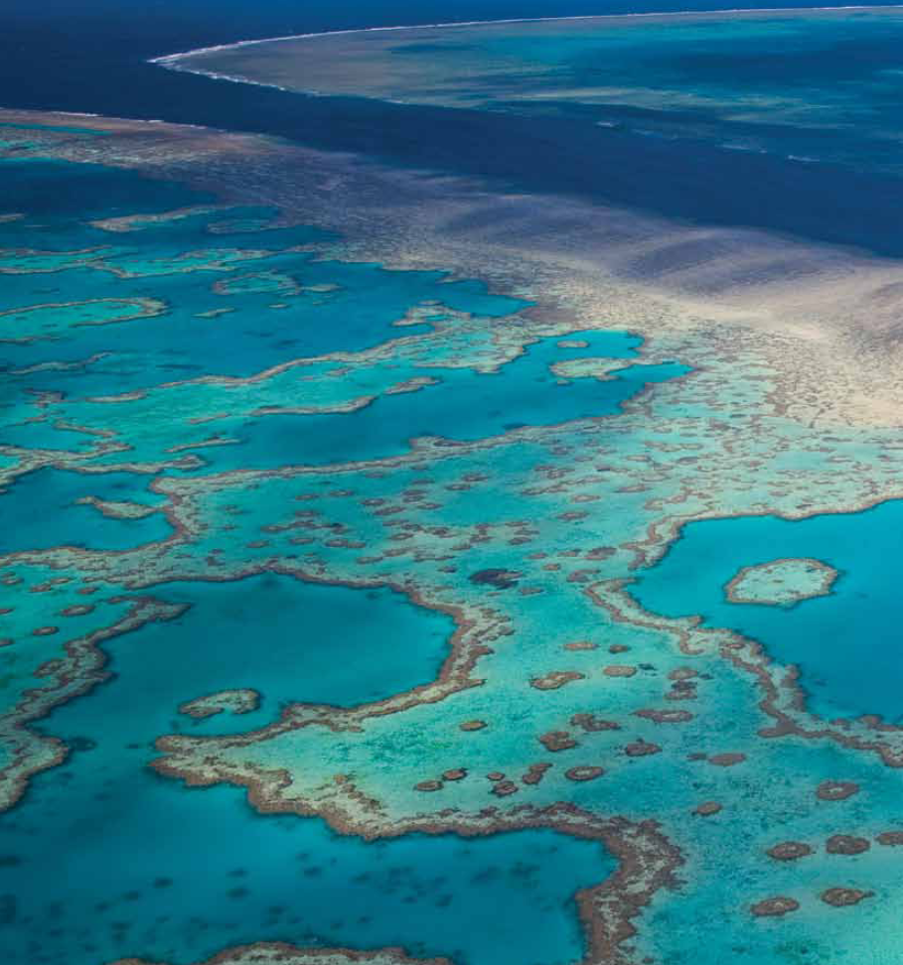
GBRMPA management tools & approaches
Tools
Approach
Legislation, plans, permits, policy, procedures
Social Science??
Present the GBR
Regulate access
Mitigate impacts –
cc
Education, planning, EIA, monitoring, stewardship, enforcement, partnerships

Slide 8
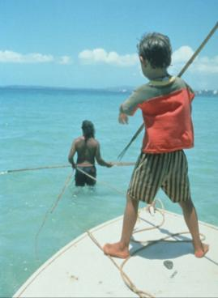
Social science
  Identify changes in demographics, coastal activities, and people's values & perceptions of issues
  Respond to community perceptions & concerns
  Keep a 'finger on the pulse' of Reef-dependent communities & industries
  Assess trade-offs between competing objectives
  Highlight the importance of non-market ‘values’
  Identify opportunities & benefits for human wellbeing and Reef resilience

Slide 9

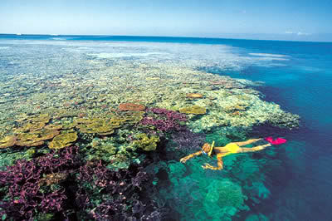
Social science
Further, the social science program contributes to a variety of initiatives within GBRMPA including:
Partnerships with key stakeholders and Reef users
Capacity-building of Reef-dependent individuals and industries in the face of change eg extreme weather events
Relies on a range of researchers to deliver timely data
FOCUS: Extreme weather & 2 NERP Projects

Slide 10
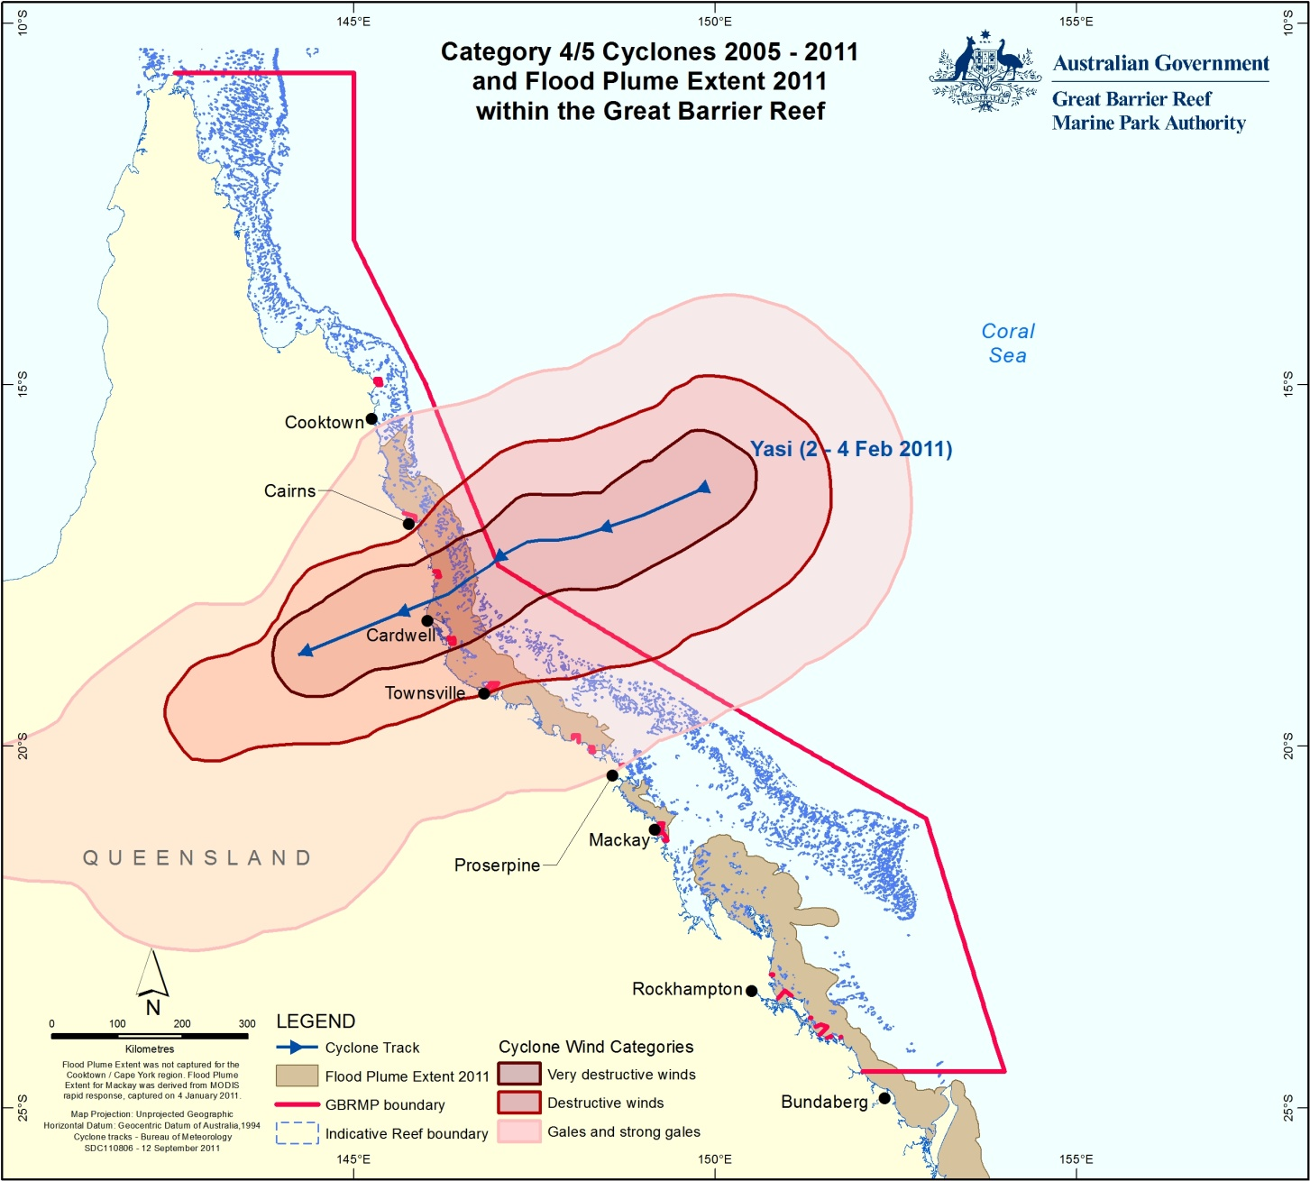
Extreme weather
Cyclone Yasi & Flood Plume
Impacts on community & Reef-dependent industries?
(Marine tourism & commercial fishing)
telephone surveys
interviews
two workshops
Notes:
Summer 2010-11 – TC Yasi (Townsville to Cairns) plus Flood Plume Extent 2011

Slide 11
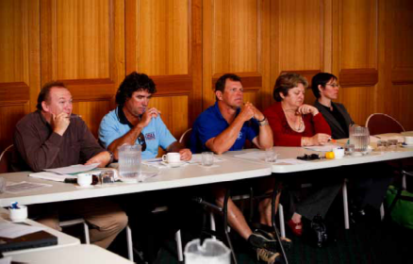
Extreme weather
Natural systems
site access, scenic quality, biodiversity
Personal circumstances
Health, personal safety, outmigration, security
Local communities
Networks, support, wellbeing
Infrastructure
Road, rail, telecoms, airports, jetties, ports, sewage
Business
Staff recruitment & retention , $ damage to assets, loss of income
Impacts on community & Reef-dependent industries?
Two Social Science Reports
1. Marshall & Tobin
2. Moon & Gooch
Notes:
This project focused on the impact of extreme weather events of 2010/2011 on 2 reef-dependent industries – marine tourism and commercial fishing.
Renae Tobin and Nadine Marshall undertook a telephone survey of 200 affected individuals;
GBRMPA held two industry workshops to provide feedback about the surveys and to ask participants to rate their perceptions of the impact of these events across 5 categories – natural systems, personal impacts, community impacts, infrastructure damage and business impacts. The workshop discussions about the impacts were recorded and will be used to develop a rapid impact assessment tool for use in future events.
Surveys and workshops revealed that both industries were already under stress from external pressures such as the Global Financial Crisis, the rising AUD, cost of imported seafood, rising fuel prices. They found that nearly all individuals in both industries were impacted to a larger or smaller extent – many were still suffering several months after the events.
The biggest impact on the tourism industry was the way in which the events were reported in national and international media – causing many cancellations well into the future.
Two reports were generated from this work.

Slide 12
NERP 10.2: Socio-economic systems
& reef resilience (Prof Natalie Stoeckl)
Objectives
1. Improve understanding of what residents and tourists do in the GBR and think is important about the GBR – e.g. fishing, boating, snorkeling, or reef-based jobs – COMPARED to things such as mining jobs
2. Determine whether residents or tourists are concerned about impacts & think it is worth ‘paying’ to protect the GBRWHA
3. Assess extent to which healthy marine environments contribute to
Overall life-satisfaction (well-being) of residents
Overall satisfaction of tourists with their stay in the region
4. Assess impacts of deterioration in e.g. live coral cover, water clarity, fish abundance might have on
Overall life satisfaction of residents; and
Length of tourist stay
5. Determine extent to which market prices may be able to influence water quality in the GBR lagoon
Notes:
Natalie and her team are conducting the first stage of the surveys as we speak.
For Objective 5, Natalie’s team will look for evidence that changes in beef prices have, historically, impacted sediment loads in the Burdekin (thus learning more about the extent to which market prices (and by extension market-based instruments such as taxes) may be able to influence water quality in the GBR lagoon
NB: Can't always equate economic wealth with capacity to enhance Reef resilience and human well-being.
Data generated from this project together with the next one (NERP Project 10.1) will provide much needed information for the next outlook report, which will be finalised in 2014.

Slide 13
NERP 10.1: SELTMP (Dr Nadine Marshall)
Long term monitoring …how do people use & benefit from the GBR?
Top down (MEA) – tight linkages between environmental & human conditions
Bottom up
  10 working groups
  SSAP
  Steering committee
Who? What? Where? When? Why? How?
What data already exists?
What data is relevant?
Where are the gaps?
Notes:
We hope this will become a 20 year project that delivers timely data for outlook report cycles and other major reporting cycles.

Slide 14
Strategic
Advisory Component
Steering Committee
SSAP
Industry, GBRF, Researchers, Govt, TOs
Advisor
Output
Shipping
TOs
Comm
Fish &
Aquacult
External Processes
Drivers of change
Catchment
Industry
Human stories
economics
Recreation
Marine
Tourism
Working Groups: Technical Advisory Component
Coastal
Community

Slide 15
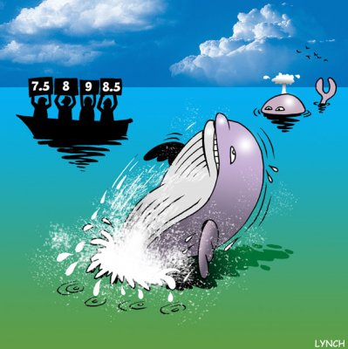
Reliable, relevant data!

Slide 16
Conclusion
Tangible benefits of management are constrained by particular ecological, economic, social and cultural conditions
need to be monitored over time
Variables selected for long-term monitoring should provide reliable, relevant information which:
measure interactions between sub-systems (social, cultural, economic & ecological)
are clearly associated with the GBRMPA's goal of promoting Reef resilience

Slide 17
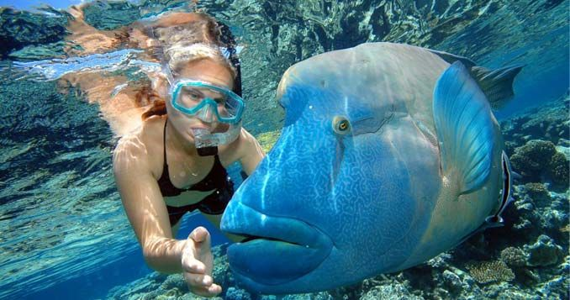

Questions?
Thanks!
Margaret Gooch, Erin Bohensky, Kirstin Dobbs, Ally Lankester, Nadine Marshall, Petina Pert, Samantha Stone-Jovicich,
Natalie Stoeckl, Renae Tobin, Karen Vohland, Liz Wren, Hugh Yorkston

